Slide 1
Chapter 5:
Physiology of Phonation - Part II
Malachi Henry, MA, CCC-SLP
Lecture 2 of 2

Slide 2
Review/Questions
section five
Physiology of Phonation
Page #

Slide 3
Basics
Frequency:
# of cycles per second
(Hertz, or Hz)
Old term was “cycles per second,” CPS
Period:
The time taken to complete one cycle (in milliseconds [ms])
Acoustics Review
Page #

Slide 4
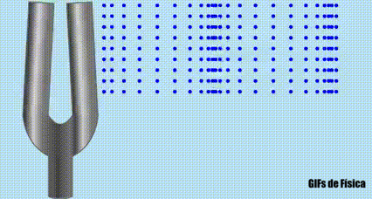
Resonance
The tendency for a body to vibrate at a specific frequency, based upon physical characteristics of the vibrating body.
e.g., tuning fork, swing
To change resonant frequency, alter length, tension, mass
Acoustics Review
Page #

Slide 5
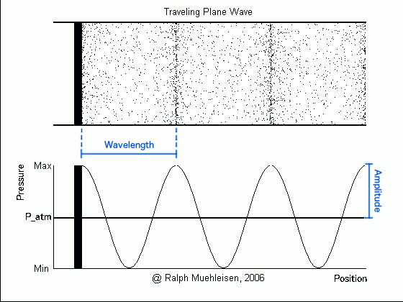
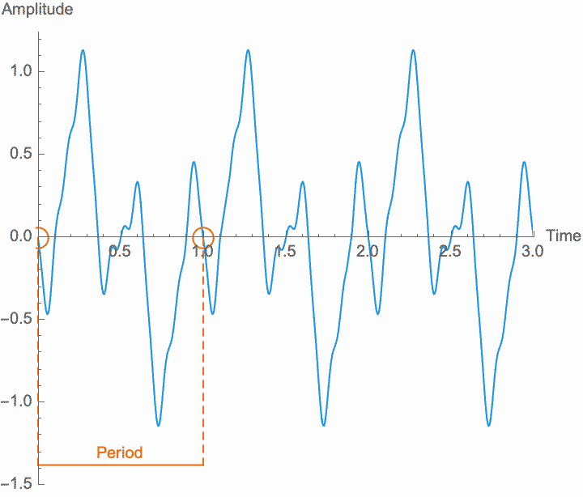
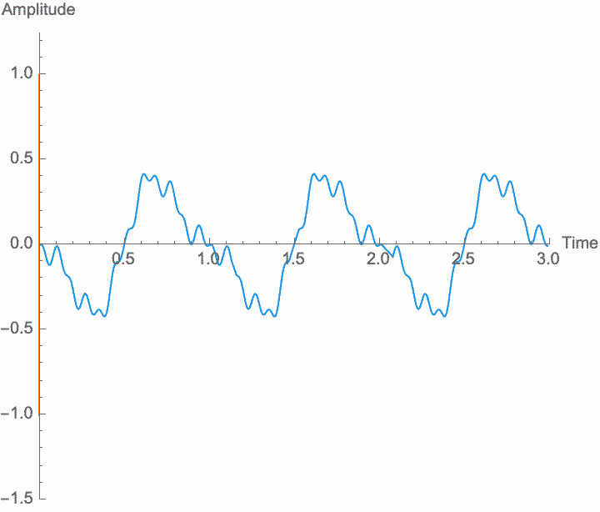
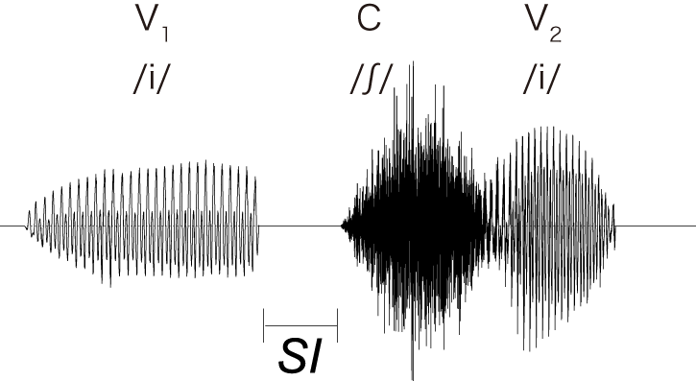
4 Types
of Sound
Simple Periodic
Complex Periodic
Aperiodic
Mixed periodic/aperiodic
Team Name

Slide 6
As tension increases, pitch increases…
As mass increases, pitch decreases…
Muscles that tense will raise pitch
Muscles that relax will lower pitch
Muscles that decrease length will lower pitch
Muscles that increase length raise pitch
How Do We Change Pitch?
Laryngeal Adjustments
Page #

Slide 7
Index & Content
Prenatal Development
Infancy Through Adulthood
Aging Effects
Vocal/Laryngeal Pathologies
Review Questions
Physiology of Phonation
Page #

Slide 8
Prenatal Development
section one
Physiology of Phonation
Page #

Slide 9
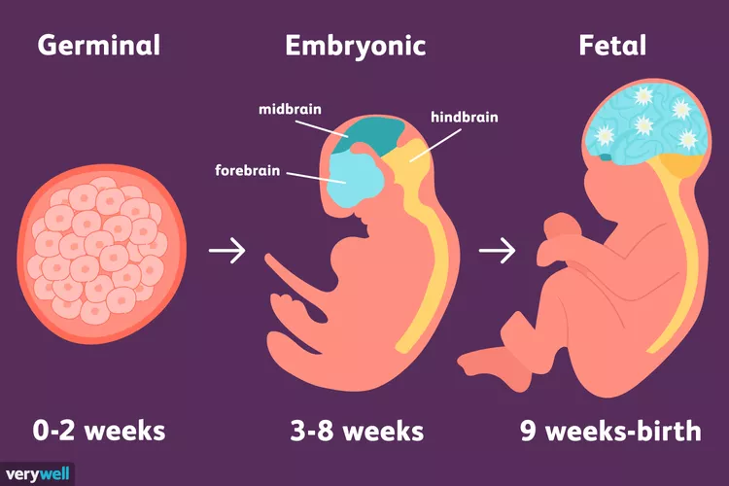
Development of the larynx is intertwined with that of the respiratory mechanism
Prenatal Development of the Phonatory Mechanism
Laryngeal Adjustments
Page #

Slide 10
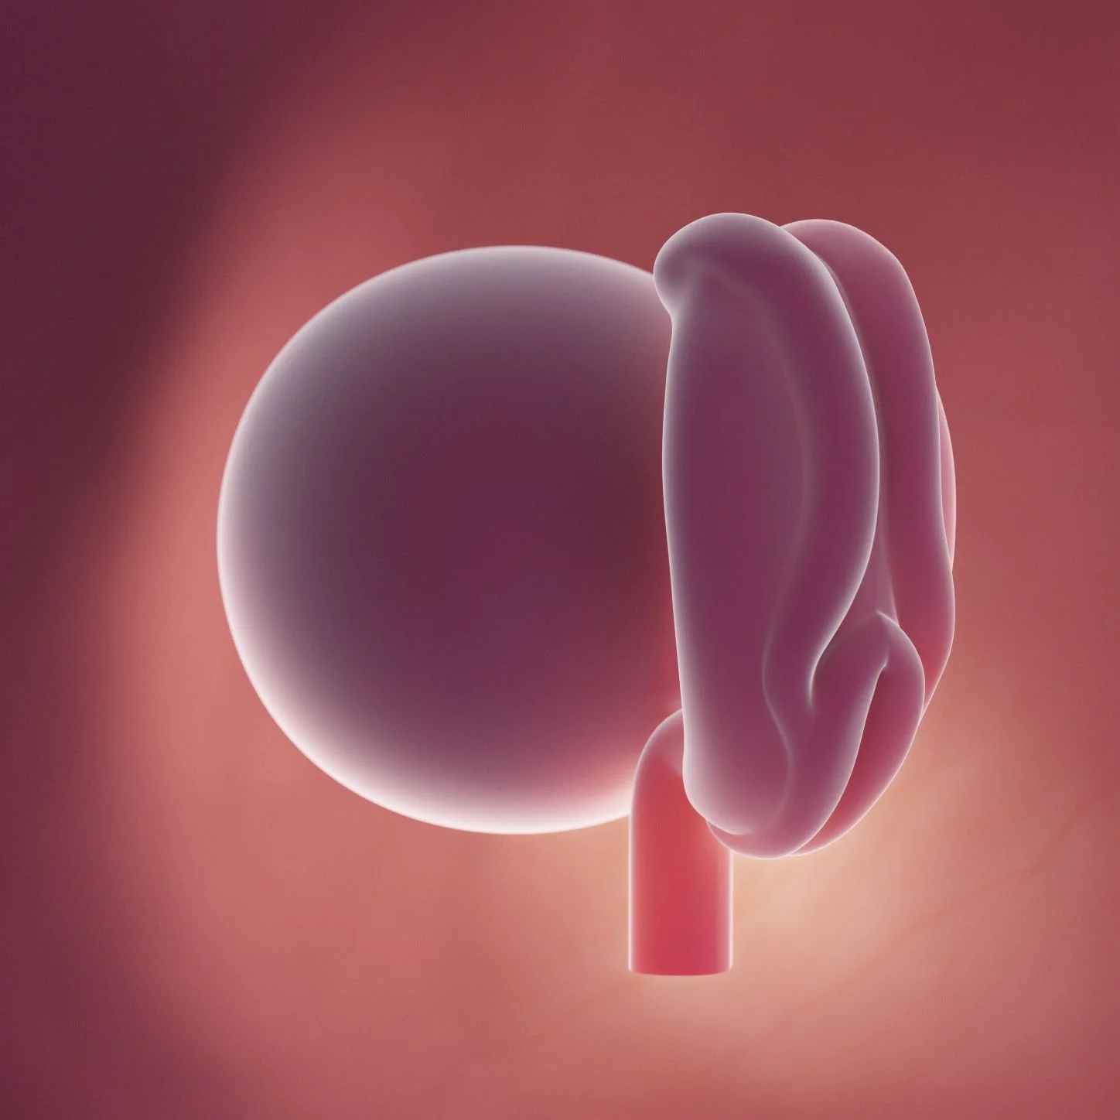
The Beginning…
Week 4: Neural crest cell migration occurs
Migrate from margins of the embryo’s neural plate
Will differentiate to form structures of head and neck
Become the pharyngeal arch system
Acoustics Review
Page #

Slide 11
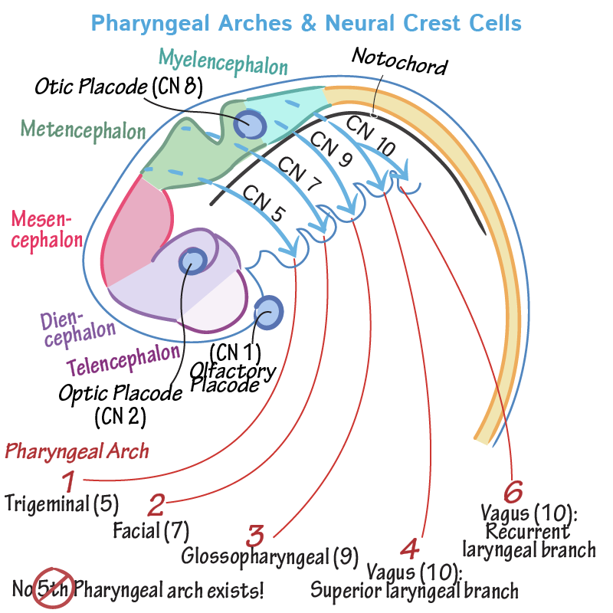
Pharyngeal Arches of Phonation
Hyoid (2nd) Arch: Part of hyoid bone
3rd Arch: the rest of the hyoid bone
4th & 6th Arches:
Pharyngeal, recurrent, superior laryngeal nerves of X vagus;
Extrinsic and intrinsic laryngeal muscles
Thyroid, corniculate, cuneiform, and arytenoid cartilages
Acoustics Review
Page #

Slide 12
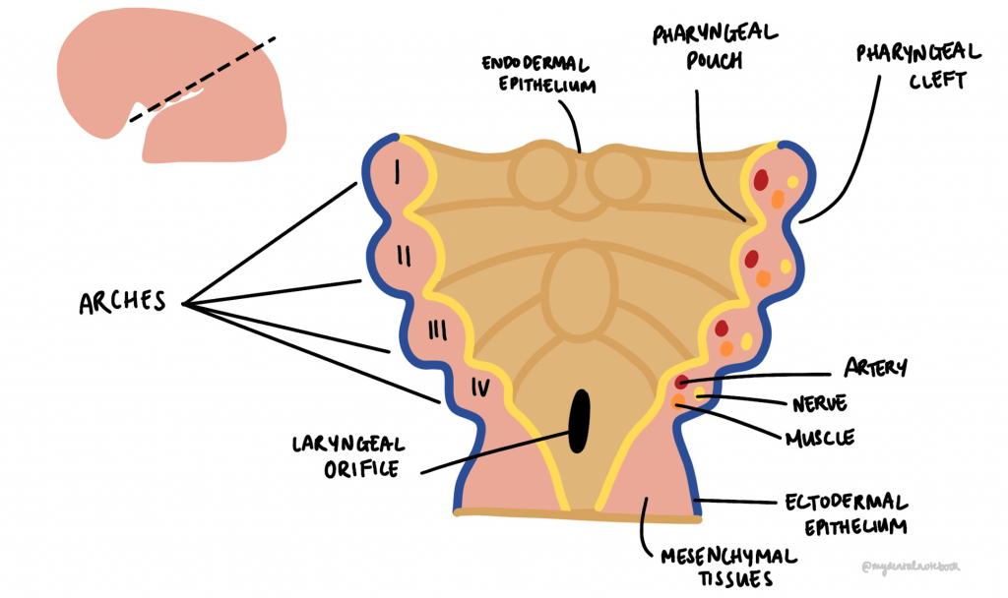
Pharyngeal Arches of Phonation
Hyoid (2nd) Arch: Part of hyoid bone
3rd Arch: the rest of the hyoid bone
4th & 6th Arches:
Pharyngeal, recurrent, superior laryngeal nerves of X vagus;
Extrinsic and intrinsic laryngeal muscles
Thyroid, corniculate, cuneiform, and arytenoid cartilages
Acoustics Review
Page #

Slide 13
Timeline of Development
Early in 4th week
The laryngotracheal diverticulum develops from pharyngeal tube, then forms the respiratory bud (later to be lungs)
End of week 4:
Respiratory system arises from the laryngotracheal pouch of the 4th pharyngeal arch
Endoderm of 4th arch forms glands of larynx, trachea and bronchi, and pulmonary epithelium
Acoustics Review
Page #

Slide 14
Timeline of Development
Respiratory tree communicates with pharyngeal tube by means of laryngeal inlet:
This will become the aditus (opening) to the larynx
Splanchnic mesenchyme of 4th & 6th arches will develop into the cartilages
Arytenoids develop as a swelling; then glottis, laryngeal ventricles, vocal folds, epiglottis, ventricular folds
Acoustics Review
Page #

Slide 15
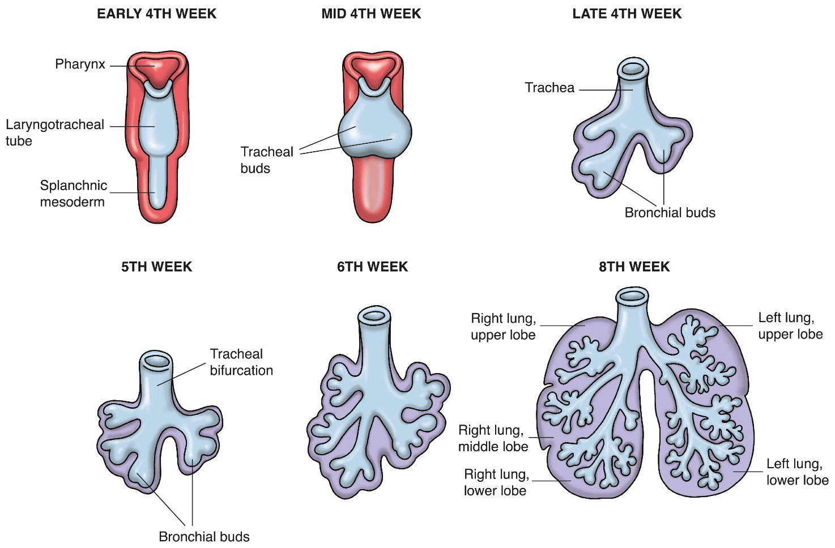
Embryonic Development: Weeks 4-8
Acoustics Review
Page #

Slide 16
Embryonic Development: Days 28-32
Week 4:
Trachea separates from esophagus as bronchial buds emerge
Week 5:
Tracheoesophageal tube develops from the diverticulum, and will become larynx, trachea, bronchi, lungs
Acoustics Review
Page #

Slide 17
Infancy Through Adulthood
section two
Phonation Development
Page #

Slide 18
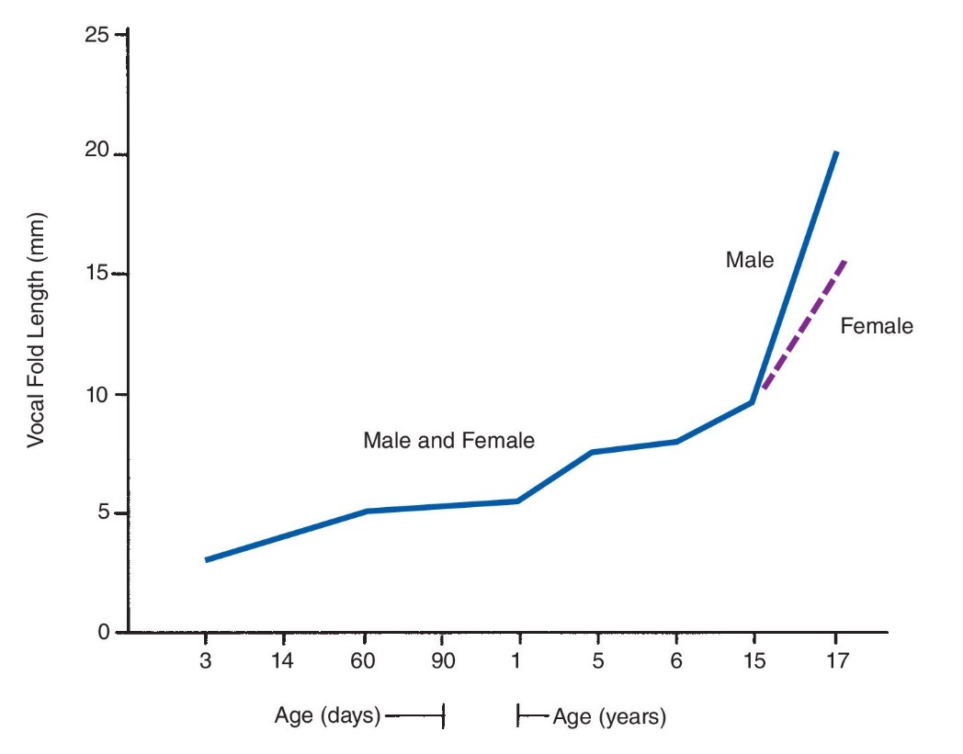
Birth and Growth
Vocal fold length:
Vocal folds are about 4 mm long at birth
Will be 12-15 mm long in adult
Note 11-16 years and changes that happen in puberty
Note sexual dimorphism at puberty
Phonation Development
Page #

Slide 19
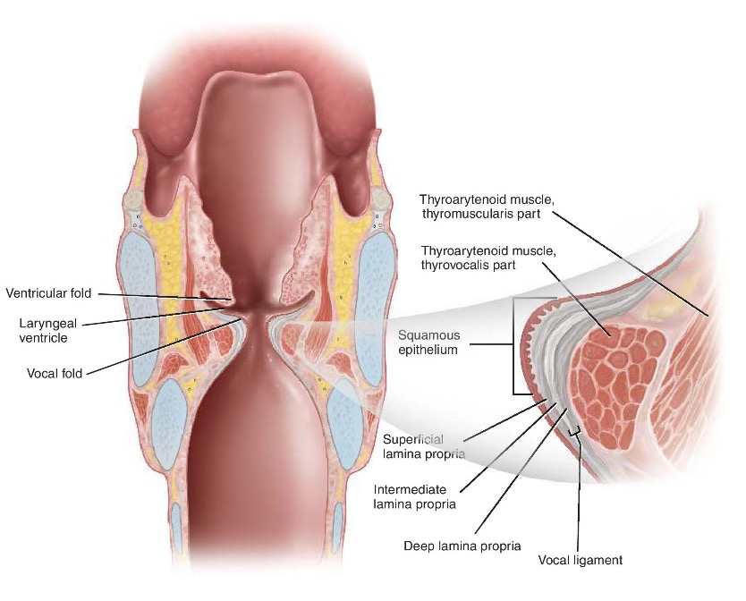
Vocal Fold Tissue Changes
5 layers of vocal folds:
Squamous epithelium: Top layer of the VF, which protects the underlying tissue and helps regulate hydration
Superficial lamina propria: Also known as Reinke's space, this layer is made of a jelly-like material that adds cushioning
Phonation Development
Page #

Slide 20
Vocal Fold Tissue Changes
5 layers of vocal folds:
Intermediate lamina propria: This layer is made of elastic fibers that add mechanical integrity
Deep lamina propria: This layer is made of collagenous fibers that insert into the thyroarytenoid muscle
Thyroarytenoid muscle: The muscle that makes up the body of the VF
Phonation Development
Page #

Slide 21
Birth Through Puberty
At first only the SLP layer
At 2 months, SLP differentiates
By 7-10 years, all layers present
By 10-16 years, layers are adult-like
Lamina propria has important implications for vibratory qualities:
Differentiates the voices of children versus adults
Phonation Development
Page #

Slide 22
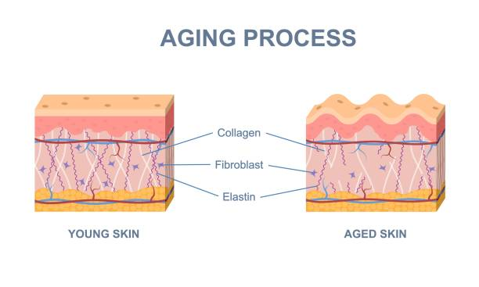
Elastin/Collagen Changes
Part of extracellular matrix, which supports the cells of VF tissues
Elastin:
provides elasticity
Collagen:
Provide structure reducing injury
What changes from infancy to adulthood?
Phonation Development
Page #

Slide 23
Elastin/Collagen Changes
Infants:
Have about 50% of adult elastin and collagen
Develops and distributes into the layers as infant develops
Adult:
SLP has no collagen or elastin
ILP has elastin but little collagen
DLP has mostly collagen, with little elastin
Phonation Development
Page #

Slide 24
Elastin/Collagen Changes
Older adults:
Lose elastin, but keep or increase collagen
Phonation Development
Page #

Slide 25
Cartilage Changes
At birth: Larynx is about 33% of adult size
Cartilage grows into adulthood
Cartilage becomes stiffer with age
At puberty:
Thyroid and cartilage grow
Male thyroid cartilage is twice the weight of female
Prominent thyroid angle, “Adam’s apple”
Cartilage growth is complete at 20 years
Phonation Development
Page #

Slide 26
Hyoid & Laryngeal Descent
Hyoid:
Ossification of hyoid occurs shortly after birth
At birth, hyoid is at level of C2/C3 vertebrae, larynx is at C3/C4)
By 2 years, larynx and hyoid are at adult locations (C3/C4 and C6/C7)
Torso is also growing, so vocal tract is lengthening
Increases resonatory volume, including subglottal space
Phonation Development
Page #

Slide 27
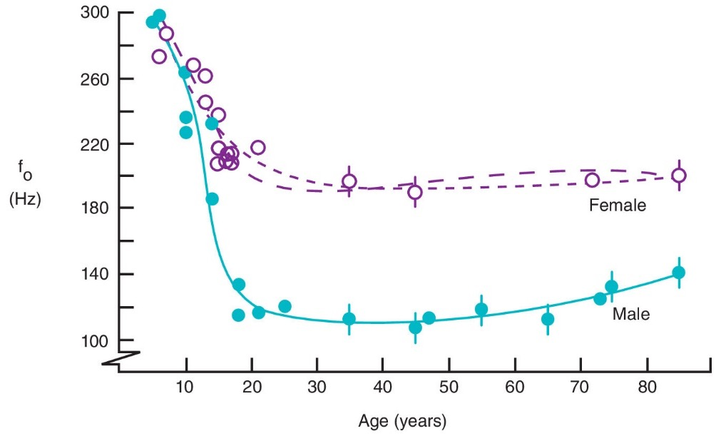
f0 Changes
Neonate has highest f0, dropping steadily
Sexual dimorphism strongly present at puberty as vocal fold mass and length increases
As respiration develops, ability to sustain phonation increases to peak in 20s
Phonation Development
Page #

Slide 28
Aging
Effects
section three
Physiology of Phonation
Page #

Slide 29
Age Effects on Structure and Function
Change as we age co-occur with respiratory changes:
Remember that respiration and phonation go hand-in-hand: The weaker the respiration, the weaker the phonatory product
Respiration begins decline in 20s, and so does the vocal mechanism
Presbyphonia:
Phonatory characteristics of geriatric vocal mechanism
Presbylarynx:
The aging laryngeal structures
Effects of Aging
Page #

Slide 30
Vocal Effects of Presbyphonia
Presbyphonia results in:
Hoarseness
Low vocal intensity
Increased breathiness
Vocal fatigue
Reduced vocal harmonics
Let’s examine what causes these changes!
Effects of Aging
Page #

Slide 31
Supportive Tissue Changes
Remember the lamina propria: SLP, ILP, DLP
Both collagen and elastin, giving strength and elasticity
Elastin decreases with age and collagen increases
This means that the vocal folds get stiffer and less elastic
Produces increased vocal fatigue and hoarseness, as well as reduced f0 range
Vocal ligament thins and frays
Effects of Aging
Page #

Slide 32
Muscle Changes with Aging
Sarcopenia (muscle atrophy):
Lose muscle fibers, and the existing fibers become thinner and smaller in diameter
Thyroarytenoid is very vulnerable, starting in around 60 years old
Weak thyrovocalis results in breathy phonation and inefficient use of already weakened respiration
Loss of elastin may result in bowing of vocal folds
Larynx descends further into pharynx because of weak supraglottal muscles
Effects of Aging
Page #

Slide 33
Cartilage & Nerve Changes
Cartilage:
Laryngeal cartilage ossifies with age (except epiglottis)
Ossification starts ~18 years of age and is complete around 70
Nerves:
RLN and SLN are very vulnerable to aging
Deterioration causes the action potential declines after 60 years
Results in inadequate adduction, f0 change, breathiness, increased vocal jitter
Also has reduced sensitivity, so more vulnerable to foreign body entry into larynx
Effects of Aging
Page #

Slide 34
F0 Changes & Aging
Adult male f0 is around 130 Hz at 20 years, then starts increasing around 70 to about 140 Hz at 80 years
Female f0 is 190 Hz at 20, and it holds relatively steady into older age
Effects of Aging
Page #

Slide 35
Acoustic Parameters
& Aging
Vocal Jitter
Vocal Intensity
Vocal Range
As we age it gets larger, because of increased variability of phonation…
Phonation gets weaker as we age…
This gets smaller as we age…
Harmonic-to-Noise Ratio
This increases as we age…
Effects of Aging

Slide 36
Vocal & Laryngeal Pathologies
section four
Physiology of Phonation
Page #

Slide 37
SLPs’ Role
The professional roles and activities in speech-language pathology include the following:
Clinical Services
Diagnosis
Assessment
Planning
Treatment
Prevention And Advocacy
Voice Pathology
Page #

Slide 38
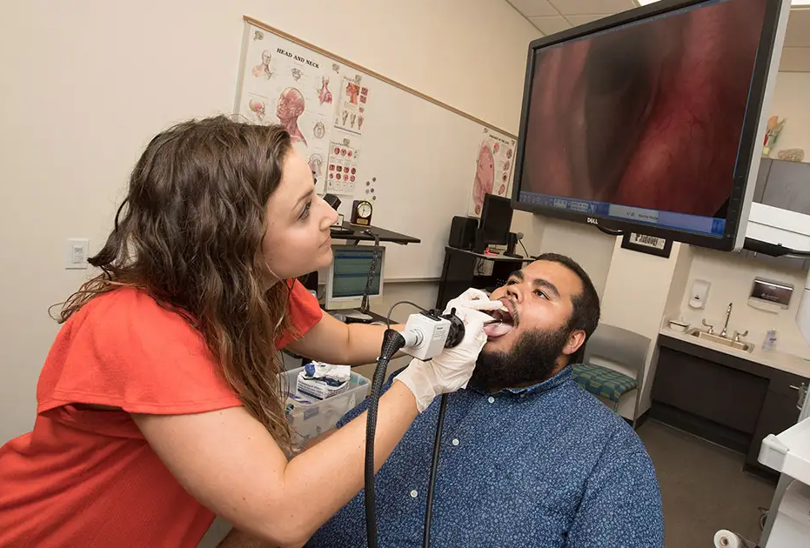
1. Instrumental
2. Auditory/Perceptual
Visualizes laryngeal structures using video stroboscopy or Laryngoscopy (nasal endoscopy)
Laryngeal Electromyography measures electrical activity in the throat muscles.
Acoustic measurement of the speech signal
Evaluation of the laryngeal mechanism (i.e., voice production) using clinical judgment
A listener judges the vocal quality
Breathiness, hoarseness, etc.
CAPE-V
Voice Diagnostics
Vocal Pathology
Page #

Slide 39
Some Common Pathologies
Voice Disorders -
Laryngitis
Vocal Fold Paresis or Paralysis
Phonotrauma
Spasmodic dysphonia
Voice Pathology
Page #

Slide 40
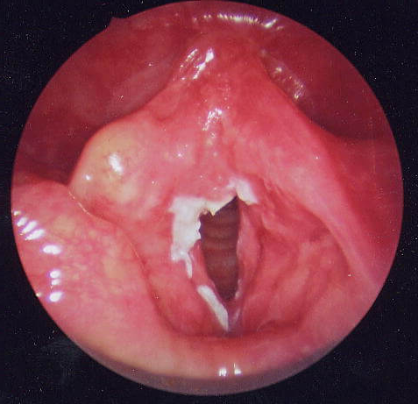
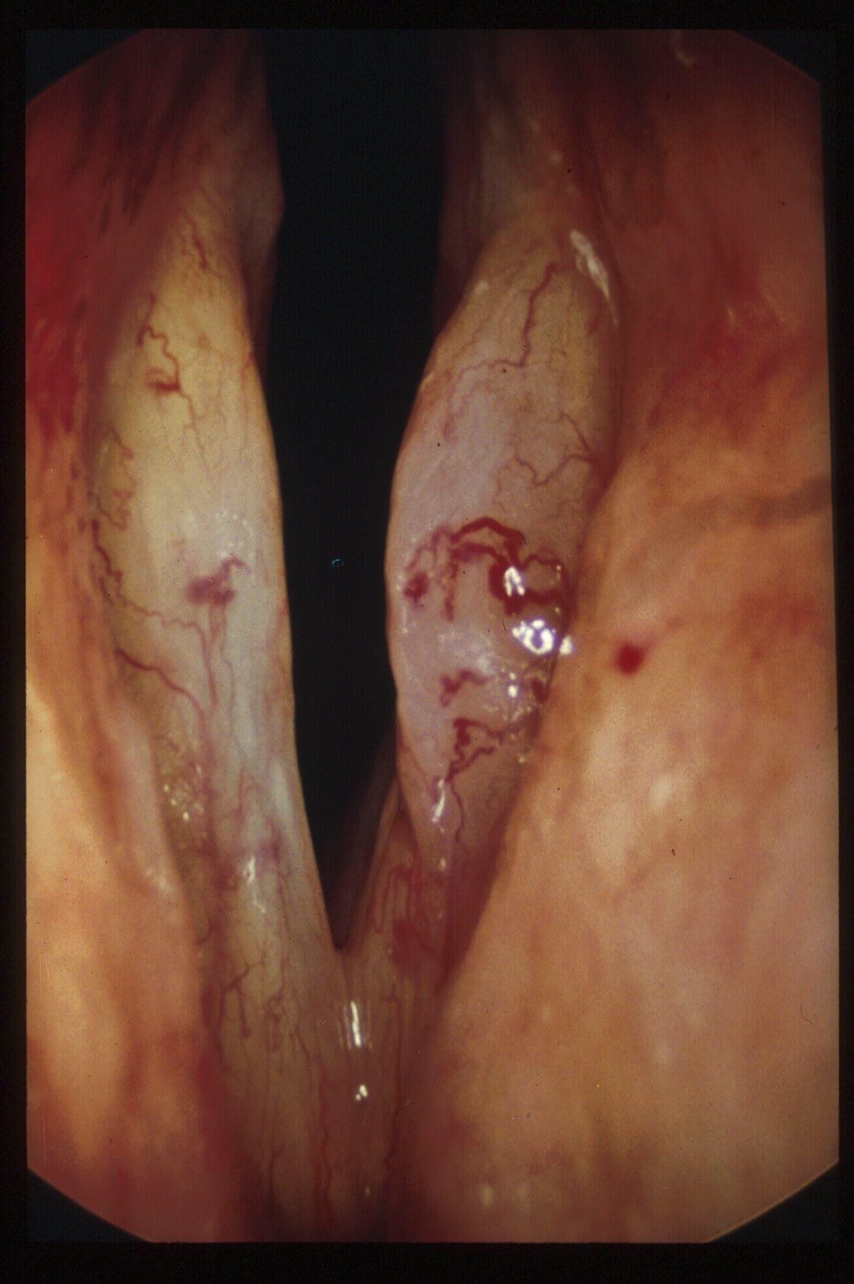
Laryngitis
Inflammation and swelling of the VF
Voice sounds hoarse, or you may not be able to speak at all
Virus in the upper respiratory tract
Chronic laryngitis caused by chronic cough, smoking, using inhalers for asthma, and GERD
The treatment of chronic laryngitis depends on the cause
Voice Pathology
Page #

Slide 41
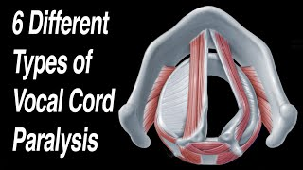
VF Paresis & Paralysis
VF can be paralyzed or partly paralyzed (paresis).
Viral infection of VF nerves, injury to a nerve during surgery, damage from breathing tube placement, stroke, or cancer.
In a closed position, you may have noisy or difficult breathing.
In an open position, you may have a weak, breathy voice.
May get better over time, but paralysis may be lifelong (permanent).
Surgery and voice therapy may help improve the voice.
Voice Pathology
Page #

Slide 42
Phonotrauma
People who use their voice a lot are most susceptible to phonotrauma:
Teachers, salespeople, broadcasters, lawyers, as well as singers or actors
Phonotrauma can manifest a number of different ways:
Vocal Nodules (calluses): Superficial lesions on VF lining, usually occur in the middle of both VF
VF Polyp (blister): Usually on one VF. Soft or firm, can be red if it develops after acute hemorrhage
VF Cyst: Deeper in the VF under the superficial lining, sometimes from birth, growing slowly with time
Varices and Ectasias: Abnormal blood vessels and other vascular malformations under surface of the VF that bleed and cause stiffness
VF Sulcus: Indentation in edge of VF, caused by scarring which adds mass to VF
Voice Pathology
Page #

Slide 43
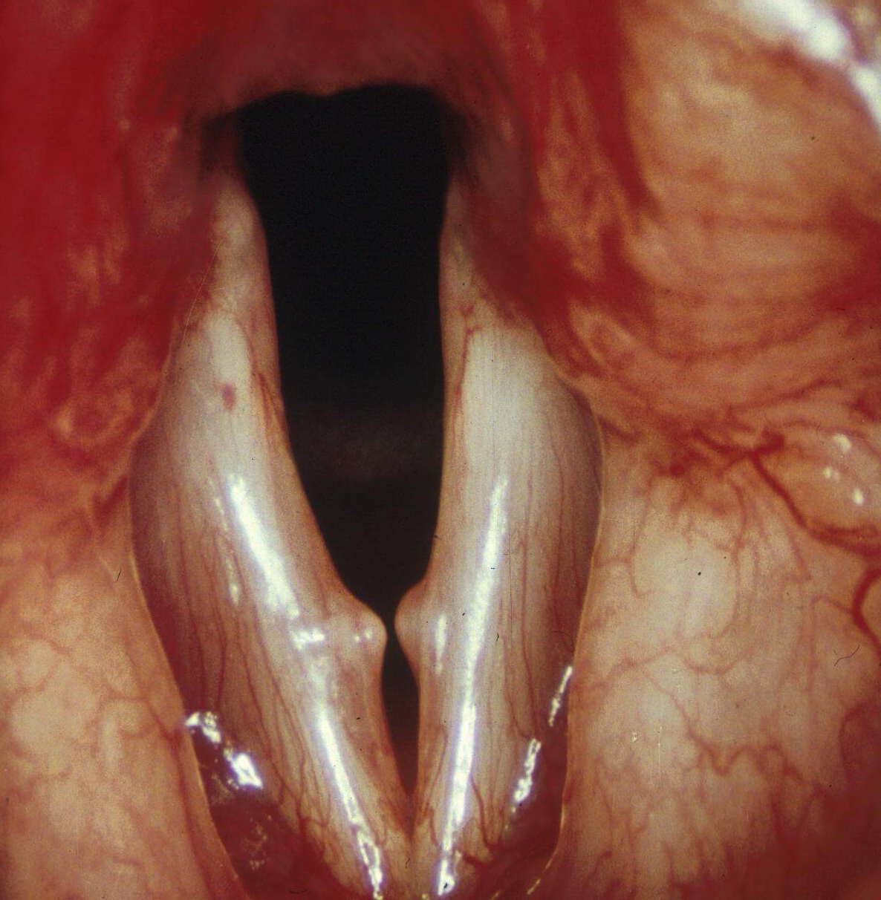
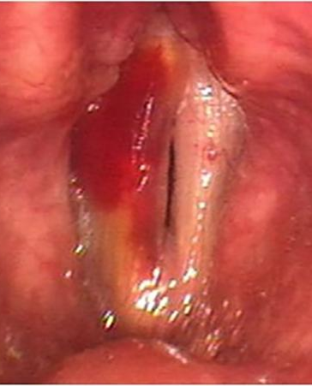
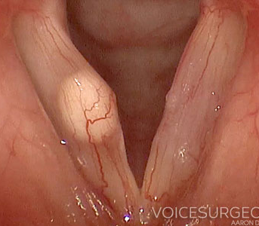
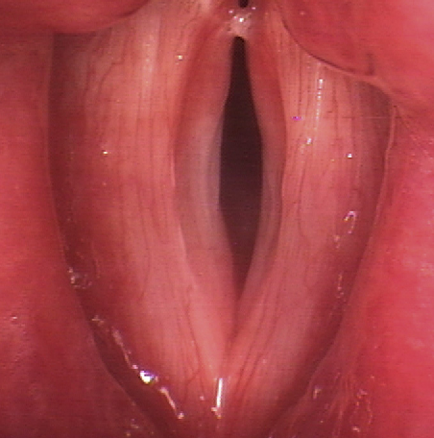
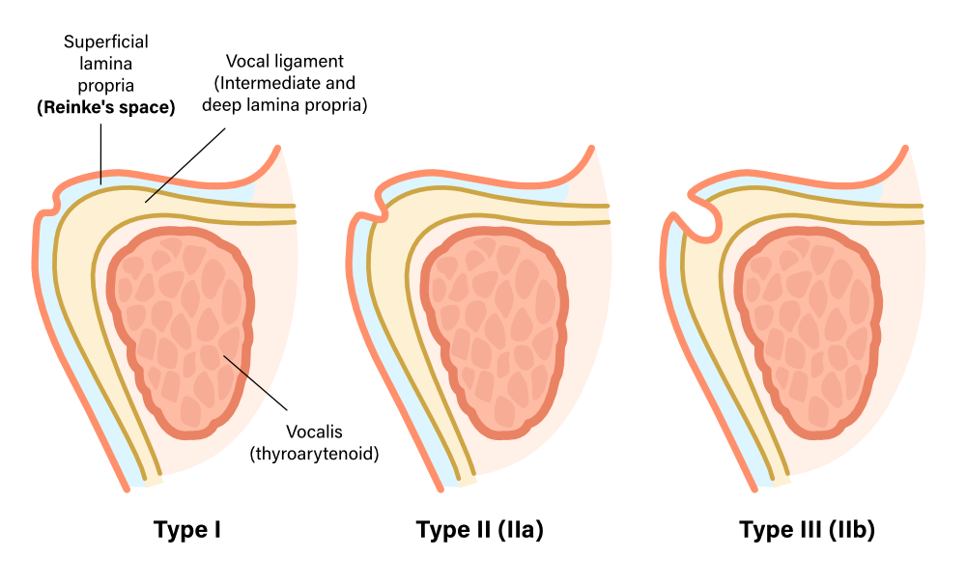
Phonotrauma
VF Polyp
Vocal Nodules
Varices/
Ectasias
VF Cyst
VF Sulcus
Voice Pathology
Page #

Slide 44
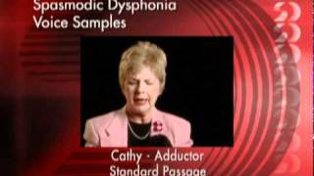
Spasmodic Dysphonia
Spasmodic Dysphonia is a nerve problem that causes the VF to spasm
It can make the voice sound tight, quivery, jerky, hoarse, or groaning
At times, the voice may sound normal
Other times, the person may not be able to speak
Treatment may include speech therapy and shots (injections) of botulinum toxin in the VF
Voice Pathology
Page #

Slide 45
SLPs’ Role - Intervention
Intervention is designed to:
Establish appropriate vocal hygiene routines/practices
Capitalize on strengths and address weaknesses related to underlying structures and functions that affect voice production
Improve self-awareness of voice quality and kinesthetic factors (e.g., tension)
Facilitate the individual’s life participation by assisting the person in acquiring new communication skills and strategies
Modify contextual factors to reduce barriers and enhance facilitators of successful communication and participation
Provide appropriate accommodations and other supports as well as training in how to use them
Voice Pathology
Page #

Slide 46
Optimal f0
Habitual f0
f0 Range
The average fundamental frequency at which vocal folds vibrate most efficiently (resonant frequency)
The average fundamental frequency at which an individual’s vocal folds vibrate during normal conversational speech
Difference between the max f0 of vibration of modal phonation and the min f0 of vibration (i.e., max_{f0}- min_{f0})
About two octaves
.25 octaves below optimal f0
1.75 octaves above f0
Male = about 90 to 360 Hz
Female = 190 to 760 Hz
Misc. Frequency Variables
Phonation Development
Page #

